Slide 1
DRIVER DISTRACTION DETECTION USING CNN
CREATED BY
P.PRIYADHARSHINI
REG.NO: 912321104032
111-YEAR CSE
SACS MAVMM ENGINEERING COLLEG,MADURAI

Slide 2
Project outline:
 Problem statement
 Proposed system/solution
 System development approach
 Algorithm and deployment
 Result
 conclusion

Slide 3
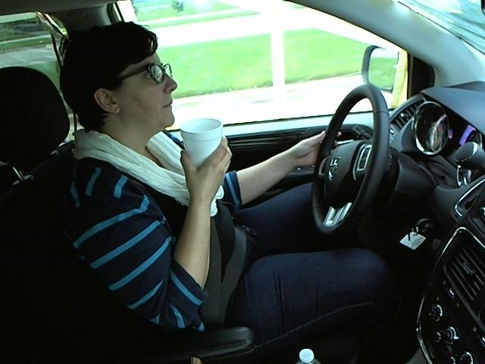
Problem Statement
In this project, I have created and refined machine learning models to detect what the driver is doing in a car given driver images.
This is done by predicting the likelihood of what the driver is doing in each picture.

Slide 4
Proposed system/solution
Propose a convolutional Neural network-based (CNN) based driver distraction detection model that uses various architectures like Resnet50, MobileNetV2 along with transfer learning.
For performance comparison, several experiments are conducted using a different number of images collected from a publicly available dataset.

Slide 5
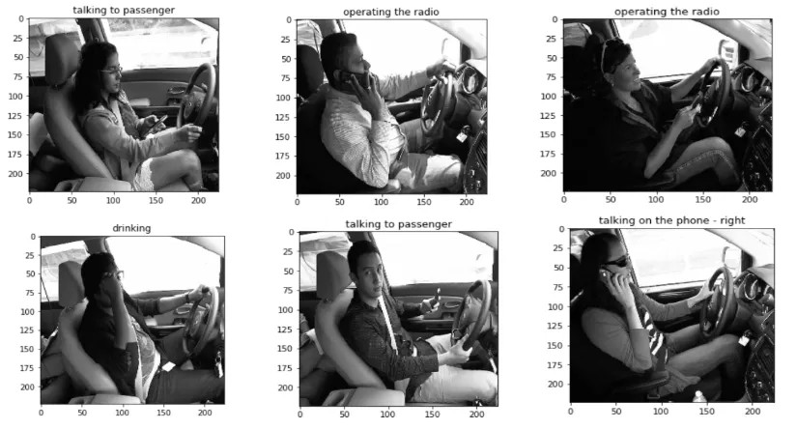
Proposed system/solution (CONTD…):
This dataset comprises thousands of images with ten different gestures of a distracted driver including sleeping, talking to others, using cell phone etc.

Slide 6
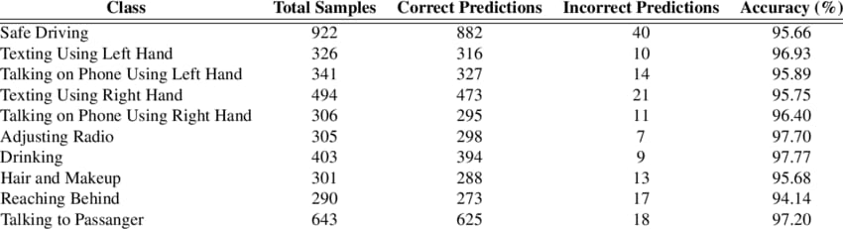
Proposed system/solution (CONTD…):
Finally, to verify the effectiveness, appropriate validation metrics such as average training time, accuracy, validation and training accuracy are considered and the results show that ResNet50 and MobileNetV2 architecture outperform the others models.

Slide 7
System development approach:
In the development of a driver distraction detection system using Convolutional Neural Networks (CNNs), a typical approach would involve several key steps:
Problem Definition: Clearly define the problem you are trying to solve, such as detecting driver distraction from images or video feeds.
Data Collection: Gather a diverse dataset of images or video clips containing examples of both distracted and non-distracted driving scenarios. Ensure the dataset is properly labeled.

Slide 8
System development approach (CONTD…):
Data Preprocessing: Preprocess the collected data, which may involve tasks such as resizing images, normalizing pixel values, and augmenting the dataset to increase its size and diversity.
Model Selection: Choose an appropriate CNN architecture for your task. This could be a pre-existing architecture like VGG, Resent, or a custom architecture tailored to your specific needs.
Model Training: Train the selected CNN model using the preprocessed dataset. This involves feeding the training data into the model, adjusting the model's parameters (weights and biases) through back propagation, and optimizing them to minimize a defined loss function.

Slide 9
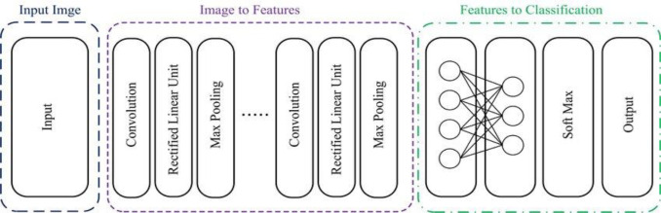
System development approach (CONTD…):
Model Evaluation:
Evaluate the trained model's performance using a separate validation dataset. Metrics such as accuracy, precision, recall, and F1 score can be used to assess the model's effectiveness in detecting driver distraction.

Slide 10
Algorithm and deployment:
Algorithm used Deep Learning - Convolutional Neural Networks
Following are needed tasks for the development of the algorithm:
step 1:
Download and preprocess the driver images Build
Step 2:
Train the model to classify the driver images Test model
Step 3:
Further improve the model using different techniques.

Slide 11
Data set State :
Farm Distracted Driver Detection Kaggle (https://www.kaggle.com/c/state-farm-distracted-driver-detection/data)
Classes Predicting the below classes based on what the driver is doing in picture :
• Safe driving
•Texting – right
• Talking on the phone – right
• Texting – left
• Talking on the phone – left
• Operating the radio
• Drinking
• Reaching behind• Hair and makeup• Talking to passenger

Slide 12
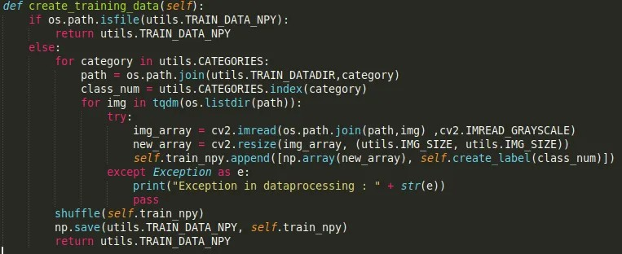
Data Processing:
Given images are of size 640 x 480 pixels so processing is too lengthy. So convert these into size 256 x 256 pixels and save into numpy array.

Slide 13
Implementation:
A standard CNN architecture was initially created and trained. We have created 4 convolutional layers with 4 max pooling layers in between.
Filters were increased from 64 to 512 in each of the convolutional layers.
Also dropout was used along with flattening layer before using the fully connected layer.
Altogether the CNN has 2 fully connected layers. Number of nodes in the last fully connected layer were setup as 10 along with softmax activation function.

Slide 14
CNN Model
Input Layer : 256 x 256 pixels images ( Color Images )Convolutional Layer : 5 different layers of different filter size with activation function “relu”Pooling : Max PoolingFully
Connected Layer : 2 layers with activation function “relu” (1024 and 512 neurons)Output Layer: fully connected layer with softmax activation
functionDropout: 60 % dropout is usedOptimizer : Adam OptimizerLoss Function : Log loss = − ( y log (p) + (1 − y) log (1−p) )

Slide 15
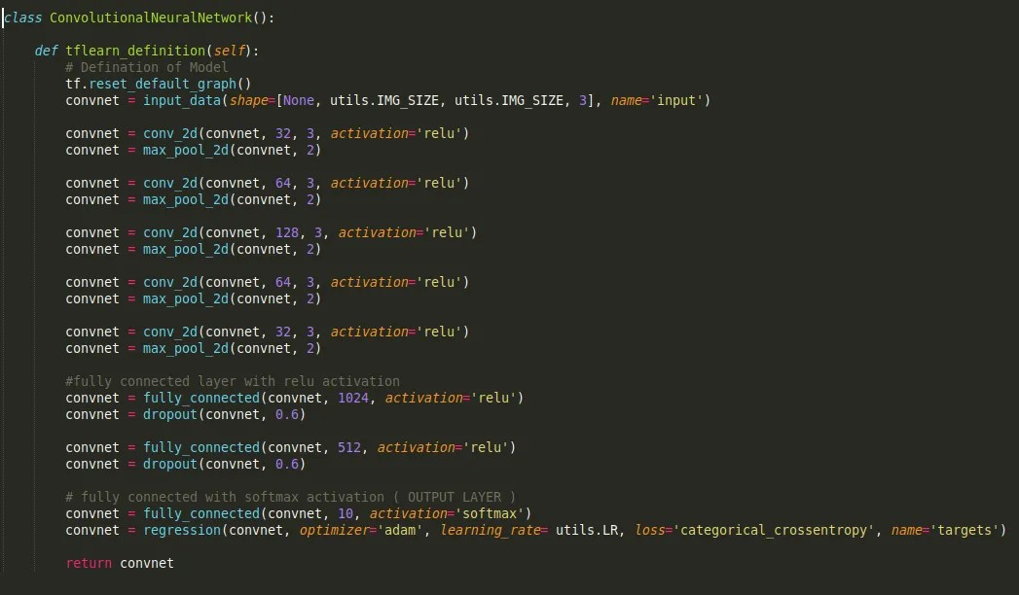
CNN Model OUTPUT

Slide 16
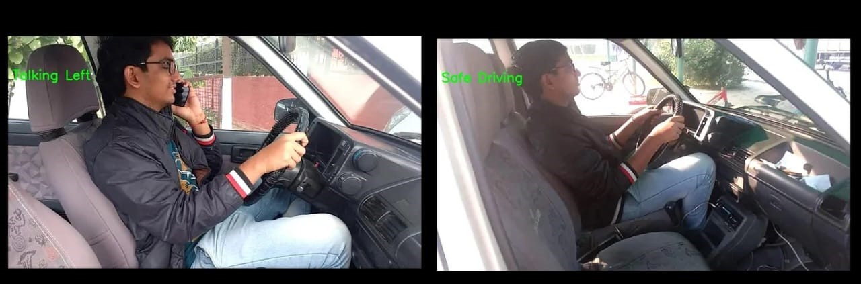
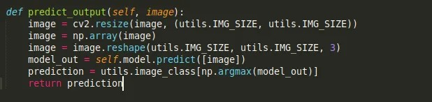
Output the class of the corresponding image

Slide 17
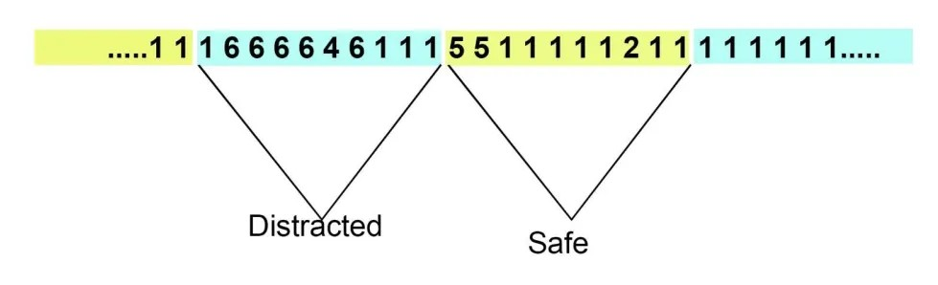
The Convolutional Neural Network provides great accuracy in identifying the images however the human actions take more than a single frame to happen.
In the implementation if out of every 10 frames more than 4 frames are showing positive distraction then an alert is generated.

Slide 18
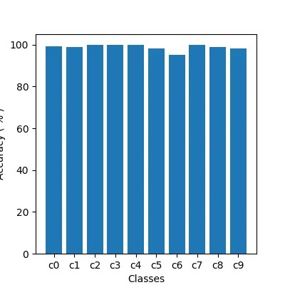
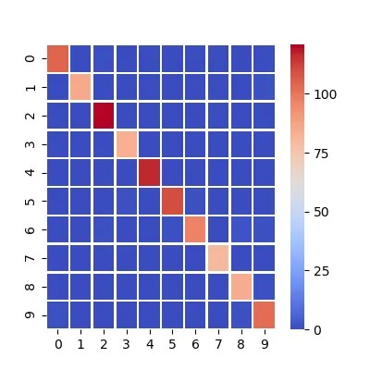
Result:
Training Accuracy: 98.37%Loss: 6.01%
Validation Accuracy: 97.8%.Validation Loss: 9.96%

Slide 19
Conclusion:
The driver distraction detection project has successfully addressed the critical issue of identifying and mitigating driver distractions to enhance road safety. it promotes safer driving behavior and reduces the risk of accidents.
Reference:
https://www.kaggle.com/c/state-farm-distracted-driver-detection.

Slide 20


